Slide 1
CS2009-Design an analysis of Algorithm
Week 5
Dr. Usman Ghous

Slide 2
Merge Sort
(Divide:) split A down the middle into two subsequences, each of size roughly n/2
(Conquer:) sort each subsequence by calling merge sort recursively on each.
(Combine:) merge the two sorted subsequences into a single sorted list

Slide 3
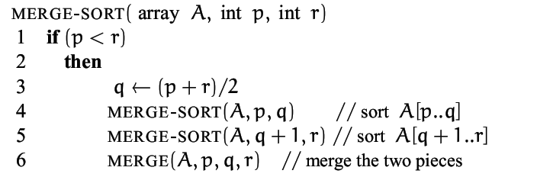
Merge Sort

Slide 4
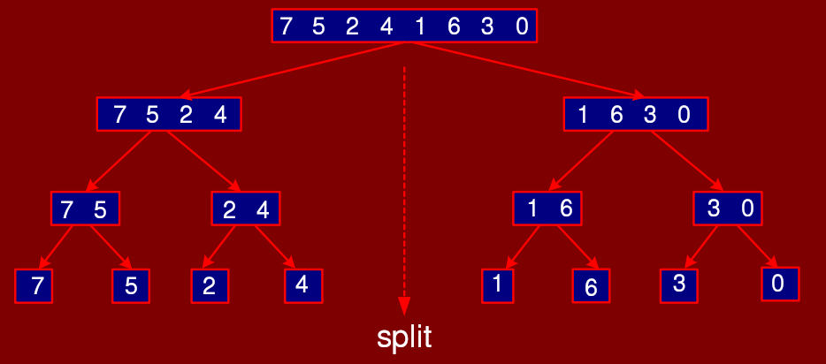
Split part

Slide 5
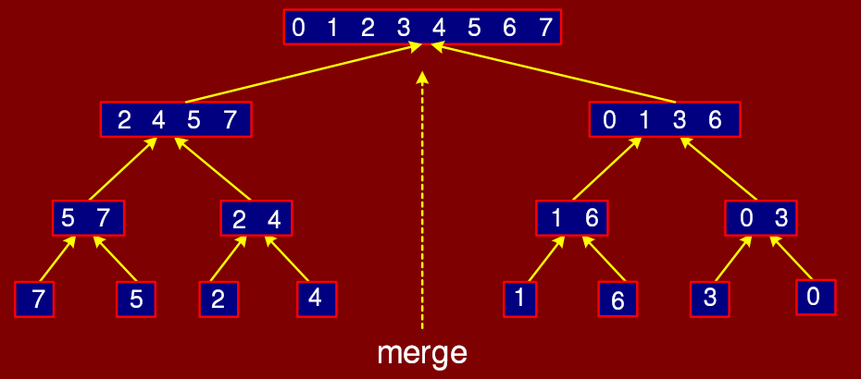
Merge Part

Slide 6
Merge Sort
The fundamental operation in this algorithm is merging two sorted lists.
Because the lists are sorted, this can be done in one pass through the input, if the output is put in a third list.
The basic merging algorithm takes
Two input arrays: a and b,
An output array: c
Three counters: aptr, bptr, and cptr,
Which are initially set to the beginning of their respective arrays.
The smaller of a[aptr] and b[bptr] is copied to the next entry in c, and the appropriate counters are advanced.
When either input list is exhausted, the remainder of the other list is copied to c.

Slide 7
Merge Sort
void m_sort( input_type a[], input_type tmp_array[ ], int left, int right )
{
int center;
if( left < right )
{
center = (left + right) / 2;
m_sort( a, tmp_array, left, center );
m_sort( a, tmp_array, center+1, right );
merge( a, tmp_array, left, center+1, right );
}
}
Calculate the centre index of the input list
Recursively call the m_sort procedure
for the left-half of the input data
Recursively call the m_sort procedure
for the right-half of the input data
Merge the two sorted lists

Slide 8
Merge Sort Example (recursive Function Calls)
Mergesort(a, 8)
m_sort( a, tmp_array, 0, 7 )
62 ⁽⁰⁾ | 58 ⁽¹⁾ | 55 ⁽²⁾ | 10 ⁽³⁾ | 45 ⁽⁴⁾ | 44 ⁽⁵⁾ | 6 ⁽⁶⁾ | 90 ⁽⁷⁾
Merge(a, tmp_array, 0, 4, 7 )
m_sort( a, tmp_array, 0, 3)
m_sort( a, tmp_array, 4, 7)
62 ⁽⁰⁾ | 58 ⁽¹⁾ | 55 ⁽²⁾ | 10 ⁽³⁾
45 ⁽⁴⁾ | 44 ⁽⁵⁾ | 6 ⁽⁶⁾ | 90 ⁽⁷⁾
62 ⁽⁰⁾ | 58 ⁽¹⁾
55 ⁽²⁾ | 10 ⁽³⁾
45 ⁽⁴⁾ | 44 ⁽⁵⁾
6 ⁽⁶⁾ | 90 ⁽⁷⁾
m_sort(0, 1)
m_sort(2, 3 )
m_sort(4, 5)
m_sort(6, 7 )
Merge(a, tmp_array, 0, 2, 3 )
Merge(a, tmp_array, 4, 6, 7 )
62 ⁽⁰⁾
58 ⁽¹⁾
55 ⁽²⁾
10 ⁽³⁾
45 ⁽⁴⁾
44 ⁽⁵⁾
6 ⁽⁶⁾
90 ⁽⁷⁾
m_sort(0,0)
m_sort(1,1)
m_sort(2,2)
m_sort(3,3)
m_sort(4,4)
m_sort(5,5)
m_sort(6,6)
m_sort(7,7)
Merge(0, 1, 1 )
Merge(2, 3, 3 )
Merge(4, 5, 5 )
Merge(6, 7, 7 )

Slide 9
Merge Sort Example (Merging process)
Mergesort(a, 8)
m_sort( a, tmp_array, 0, 7 )
62 ⁽⁰⁾ | 58 ⁽¹⁾ | 55 ⁽²⁾ | 10 ⁽³⁾ | 45 ⁽⁴⁾ | 44 ⁽⁵⁾ | 6 ⁽⁶⁾ | 90 ⁽⁷⁾
6 ⁽⁰⁾ | 10 ⁽¹⁾ | 44 ⁽²⁾ | 45 ⁽³⁾ | 55 ⁽⁴⁾ | 58 ⁽⁵⁾ | 62 ⁽⁶⁾ | 90 ⁽⁷⁾
Merge(a, tmp_array, 0, 4, 7 )
m_sort( a, tmp_array, 0, 3)
m_sort( a, tmp_array, 4, 7)
62 ⁽⁰⁾ | 58 ⁽¹⁾ | 55 ⁽²⁾ | 10 ⁽³⁾
45 ⁽⁴⁾ | 44 ⁽⁵⁾ | 6 ⁽⁶⁾ | 90 ⁽⁷⁾
62 ⁽⁰⁾ | 58 ⁽¹⁾
55 ⁽²⁾ | 10 ⁽³⁾
45 ⁽⁴⁾ | 44 ⁽⁵⁾
6 ⁽⁶⁾ | 90 ⁽⁷⁾
m_sort(0, 1)
m_sort(2, 3 )
m_sort(4, 5)
m_sort(6, 7 )
10 ⁽⁰⁾ | 55 ⁽¹⁾ | 58 ⁽²⁾ | 62 ⁽³⁾
6 ⁽⁴⁾ | 44 ⁽⁵⁾ | 45 ⁽⁶⁾ | 90 ⁽⁷⁾
Merge(a, tmp_array, 0, 2, 3 )
Merge(a, tmp_array, 4, 6, 7 )
62 ⁽⁰⁾
58 ⁽¹⁾
55 ⁽²⁾
10 ⁽³⁾
45 ⁽⁴⁾
44 ⁽⁵⁾
6 ⁽⁶⁾
90 ⁽⁷⁾
m_sort(0,0)
m_sort(1,1)
m_sort(2,2)
m_sort(3,3)
m_sort(4,4)
m_sort(5,5)
m_sort(6,6)
m_sort(7,7)
Merge(0, 1, 1 )
Merge(2, 3, 3 )
Merge(4, 5, 5 )
Merge(6, 7, 7 )
58 ⁽⁰⁾ | 62 ⁽¹⁾
10 ⁽²⁾ | 55 ⁽³⁾
44 ⁽⁴⁾ | 45 ⁽⁵⁾
6 ⁽⁶⁾ | 90 ⁽⁷⁾

Slide 10
Merge two arrays
10 ⁽⁰⁾ | 55 ⁽¹⁾ | 58 ⁽²⁾ | 62 ⁽³⁾
6 ⁽⁴⁾ | 44 ⁽⁵⁾ | 45 ⁽⁶⁾ | 90 ⁽⁷⁾
aptr
bptr
cptr
62 ⁽⁰⁾ | 58 ⁽¹⁾ | 55 ⁽²⁾ | 10 ⁽³⁾ | 45 ⁽⁴⁾ | 44 ⁽⁵⁾ | 6 ⁽⁶⁾ | 90 ⁽⁷⁾

Slide 11
Merge two arrays
10 ⁽⁰⁾ | 55 ⁽¹⁾ | 58 ⁽²⁾ | 62 ⁽³⁾
6 ⁽⁴⁾ | 44 ⁽⁵⁾ | 45 ⁽⁶⁾ | 90 ⁽⁷⁾
aptr
bptr
6 ⁽⁰⁾
cptr

Slide 12
Merge two arrays
10 ⁽⁰⁾ | 55 ⁽¹⁾ | 58 ⁽²⁾ | 62 ⁽³⁾
6 ⁽⁴⁾ | 44 ⁽⁵⁾ | 45 ⁽⁶⁾ | 90 ⁽⁷⁾
aptr
bptr
6 ⁽⁰⁾ | 10 ⁽¹⁾
cptr

Slide 13
Merge two arrays
10 ⁽⁰⁾ | 55 ⁽¹⁾ | 58 ⁽²⁾ | 62 ⁽³⁾
6 ⁽⁴⁾ | 44 ⁽⁵⁾ | 45 ⁽⁶⁾ | 90 ⁽⁷⁾
aptr
bptr
6 ⁽⁰⁾ | 10 ⁽¹⁾ | 44 ⁽²⁾
cptr

Slide 14
Merge two arrays
10 ⁽⁰⁾ | 55 ⁽¹⁾ | 58 ⁽²⁾ | 62 ⁽³⁾
6 ⁽⁴⁾ | 44 ⁽⁵⁾ | 45 ⁽⁶⁾ | 90 ⁽⁷⁾
aptr
bptr
6 ⁽⁰⁾ | 10 ⁽¹⁾ | 44 ⁽²⁾ | 45 ⁽³⁾
cptr

Slide 15
Merge two arrays
10 ⁽⁰⁾ | 55 ⁽¹⁾ | 58 ⁽²⁾ | 62 ⁽³⁾
6 ⁽⁴⁾ | 44 ⁽⁵⁾ | 45 ⁽⁶⁾ | 90 ⁽⁷⁾
aptr
bptr
6 ⁽⁰⁾ | 10 ⁽¹⁾ | 44 ⁽²⁾ | 45 ⁽³⁾ | 55 ⁽⁴⁾
cptr

Slide 16
Merge two arrays
10 ⁽⁰⁾ | 55 ⁽¹⁾ | 58 ⁽²⁾ | 62 ⁽³⁾
6 ⁽⁴⁾ | 44 ⁽⁵⁾ | 45 ⁽⁶⁾ | 90 ⁽⁷⁾
aptr
bptr
6 ⁽⁰⁾ | 10 ⁽¹⁾ | 44 ⁽²⁾ | 45 ⁽³⁾ | 55 ⁽⁴⁾ | 58 ⁽⁵⁾
cptr

Slide 17
Merge two arrays
10 ⁽⁰⁾ | 55 ⁽¹⁾ | 58 ⁽²⁾ | 62 ⁽³⁾
6 ⁽⁴⁾ | 44 ⁽⁵⁾ | 45 ⁽⁶⁾ | 90 ⁽⁷⁾
aptr
bptr
6 ⁽⁰⁾ | 10 ⁽¹⁾ | 44 ⁽²⁾ | 45 ⁽³⁾ | 55 ⁽⁴⁾ | 58 ⁽⁵⁾ | 62 ⁽⁶⁾
cptr

Slide 18
Merge two arrays
10 ⁽⁰⁾ | 55 ⁽¹⁾ | 58 ⁽²⁾ | 62 ⁽³⁾
6 ⁽⁴⁾ | 44 ⁽⁵⁾ | 45 ⁽⁶⁾ | 90 ⁽⁷⁾
aptr
bptr
6 ⁽⁰⁾ | 10 ⁽¹⁾ | 44 ⁽²⁾ | 45 ⁽³⁾ | 55 ⁽⁴⁾ | 58 ⁽⁵⁾ | 62 ⁽⁶⁾ | 90 ⁽⁷⁾
cptr

Slide 19
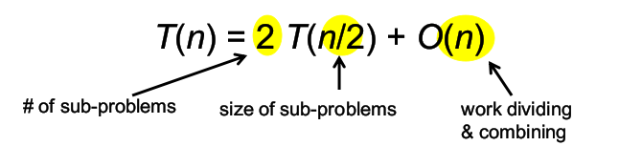
Time Complexity of merge sort using tree method, Master theorem

